Slide 1
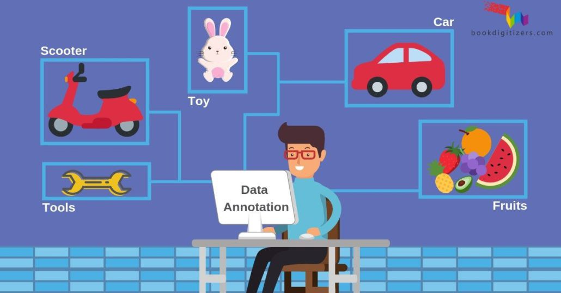
Case study: Data Annotation and data labeling services For ML
Business Challenges During ML
Understanding Which Processes Need Automation
Lack of Quality Data
Inadequate Infrastructure
Implementation
Lack of Skilled Resources
Time taken to train the Model
Solution Overview
A properly labeled dataset provides a ground truth that the ML model uses to check its predictions for accuracy and to continue refining its algorithm
Speed and Efficiency
Quality with Accuracy
Key Benefits
Provide high quality data for training train ML models.
The global data annotation market size is expected to reach US$1.6 billion by 2025, according to a new study by Grand View Research
Low-cost Training Data for AI & ML
Scalable Solution for Varied Needs

Slide 2
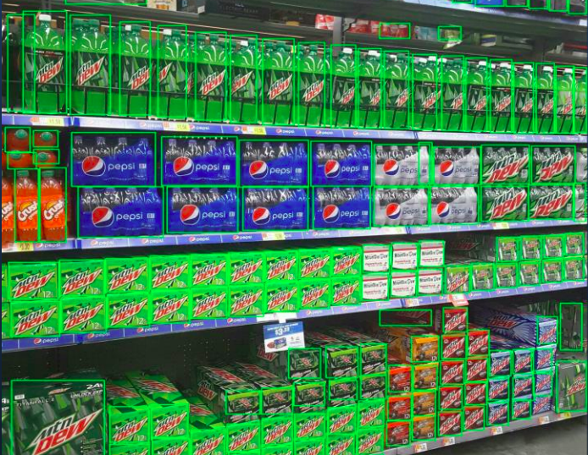
DATA ANNOTATION AND LABELING
Annotation in machine learning is the process of labelling data, which could be in the form of text, images, audio, etc. Typically, annotation is done by a human.
Supervised machine learning algorithms learn from labelled data, and those data that has been tagged with labels.

Slide 3

LIDAR AND RADAR DATA ANNOTATION
LIDAR/RADAR Annotation
Identifies objects in a 3D point cloud and draws bounding cuboids around the specified objects, returning the positions and sizes of these boxes
Point Annotation
Identifies the location of objects and draws points at specified locations, returning the locations of these points

Slide 4
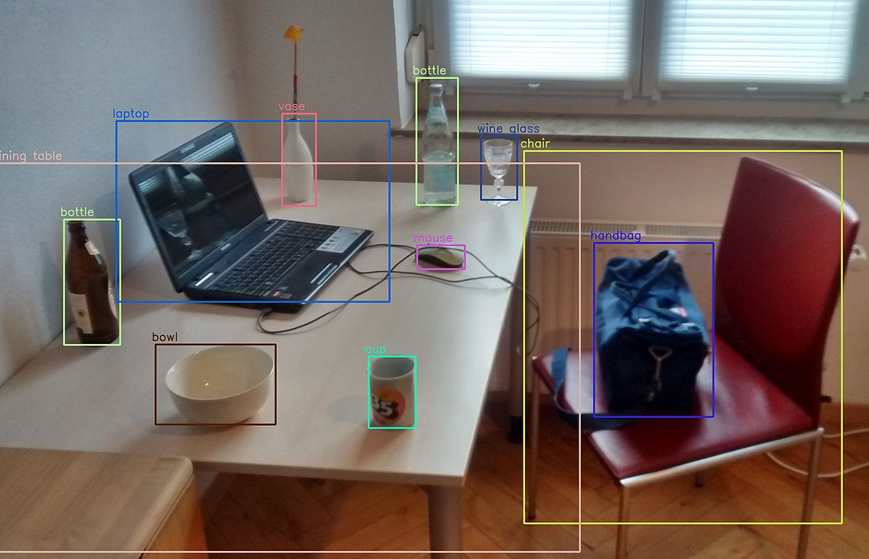
OBJECT DETECTION
Object detection is a computer vision technique that allows us to identify and locate objects in an image or video. With this kind of identification and localization, object detection can be used to count objects in a scene and determine and track their precise locations, all while accurately labelling them.

Slide 5
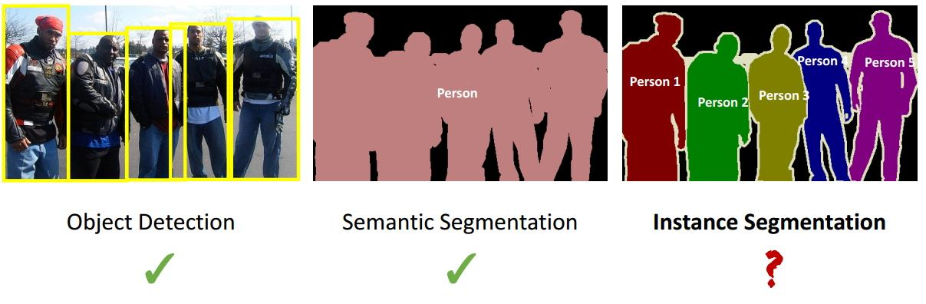
SEGMENTATION: SEMANTIC AND INSTANCE
Semantic Segmentation
Semantic segmentation refers to the process of linking each pixel in an image to a class label. These labels could include a person, car, flower, piece of furniture, etc., just to mention a few. ... Weakly- and Semi-Supervised Learning of a Deep Convolutional Network for Semantic Image Segmentation
Instance Segmentation
Instance segmentation identifies each instance of each object featured in the image instead of categorizing each pixel like in semantic segmentation. For example, instead of classifying five person as one instance, it will identify each individual person

Slide 6
MEDICAL IMAGE TRANSCRIPTION
Medical image annotation is the process of labelling the medical imaging data like Ultrasound, MRI, and CT Scan, etc. for machine learning training. Apart from these radiologist images, other medical records available in the text formats are also annotated to make it understandable to machines through deep learning algorithms for accurate predictions.

Slide 7
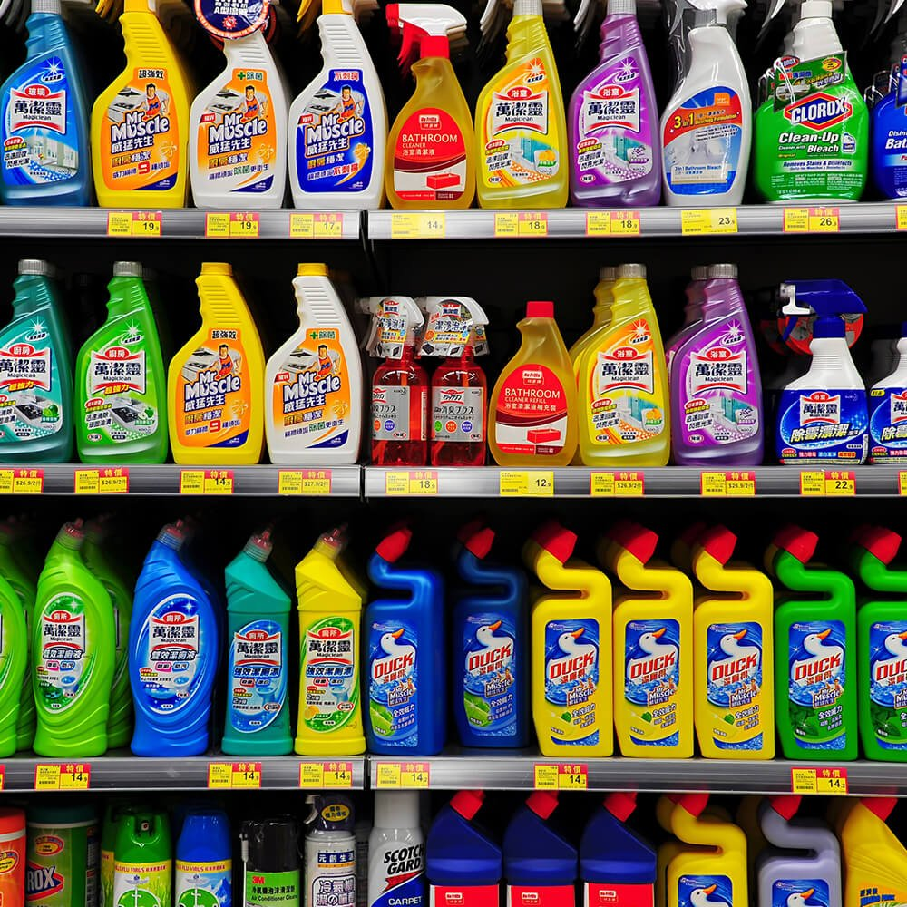
IMAGE LABELLING
Image Labeling is the process of recognizing different entities in an image. One can recognize various entities like animals, plants, food, activities, colors, things, fictional characters, drinks etc. with Image Labeling.
Bounding Boxes
Polygonal Selection
Cuboid Selection
Attributes Tagging

Slide 8
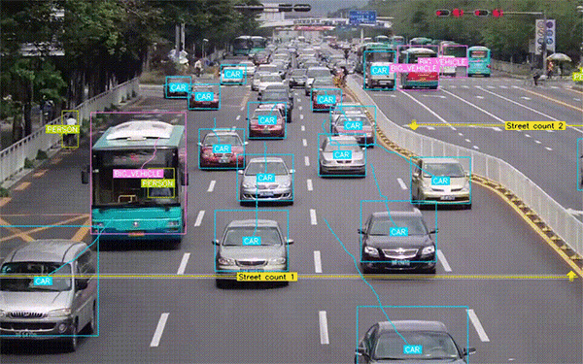
VIDEO LABELLING
Video annotation involves adding meta data to unlabeled video in order to train a machine learning algorithm. This meta data, also referred to as tags or labels, could be anything from a bounding box around a certain part of the image to full segmentation, where every pixel is annotated with its semantic meaning.

Slide 9
TEXT DECODING
OCR and ICR
Decoding and Transcription
Comparison and De-duplication
Classification and Extraction

Slide 10
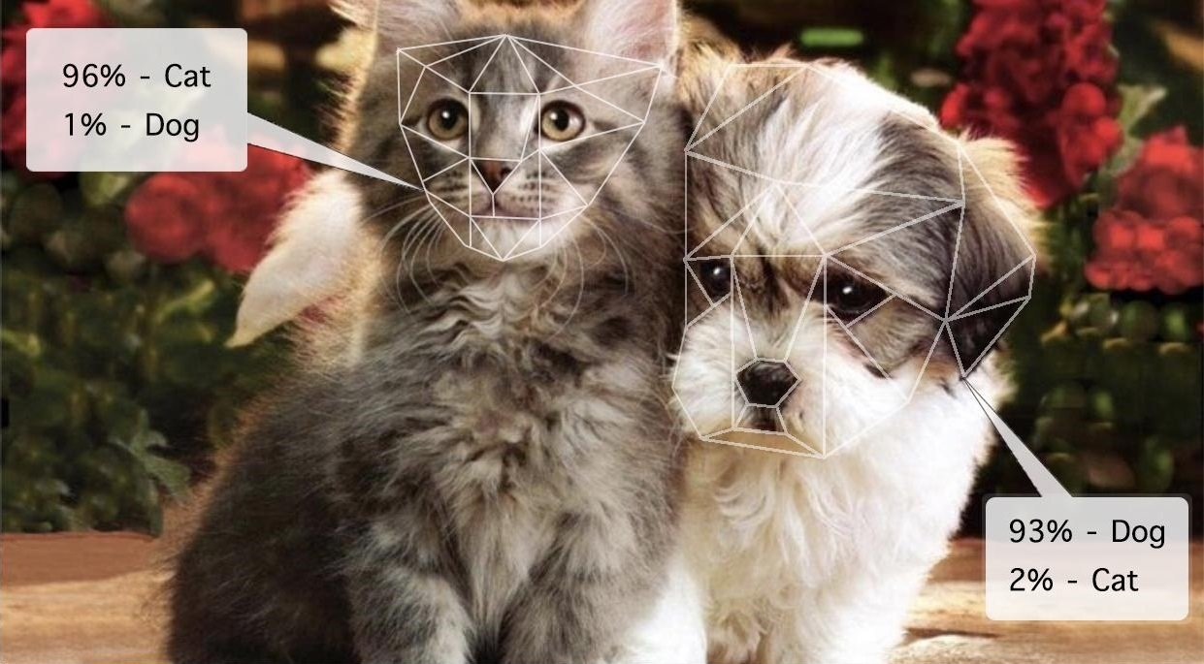
IMAGE RECOGNITION
Image recognition is a computer vision task that works to identify and categorize various elements of images and or videos.
For instance, if one want to build an image recognition model that automatically determined whether or not a dog was in a given image, the pipeline would, broadly speaking, look like this:
•Image recognition model trained on images that have been labelled as “dog” or “not dog”
•Model input : Image or video frame
•Model output : Class name (i.e. dog) with a confidence score that indicates the likelihood of that image containing that class of object.
Confidence Score
Label

